Slide 1
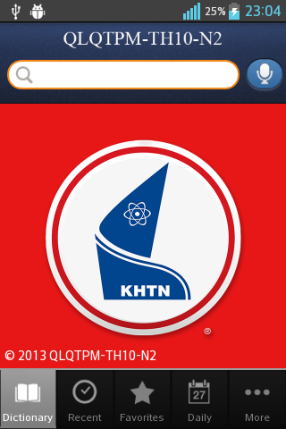
Dictionary QLQT
Nhóm 2
GVLT: Ngô Huy Biên

Slide 2
Content
Feature
Demo
Download

Slide 3



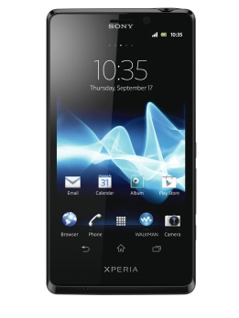


Feature

Slide 4
Demo

Slide 5
Download
https://play.google.com/store/apps/details?id=com.hcmus.dictionaryqlqt

Slide 6
Thank you!

